Slide 1
Behavior-driven Clustering of
Queries into Topics
Date: 2012/8/13
Source: Luca Maria Aiello. al(CIKM’11)
Advisor: Jia-ling, Koh
Speaker: Jiun Jia, Chiou

Slide 2
Outline
Introduction
Mission similarity classifier
Greedy agglomerative topic extraction
Experiment
User profiling
Conclusion

Slide 3
Introduction
Categorization of web-search queries in semantically coherent topics is a crucial task to understand the interest trends of search engine user.
Query clustering usually relies on lexical and clickthrough data, while the information originating from the user actions in submitting their queries is currently neglected.
The intent that drives users to submit their requests is an important element for meaningful aggregation of queries.
activity fragments that express a coherent user
intent, on the basis of their topical affinity.

Slide 4
Introduction
Users searching the web often perform a sequence, or chain, of queries with a similar information need.
most of the needs are actually too complex to
be satisfied by just one query
users are inclined
to organize their search activity in so-called missions.

Slide 5
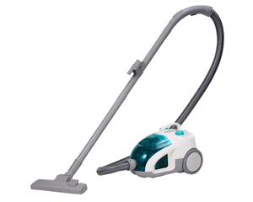
Introduction
Vacuum cleaner
information about available brands and models
look for reviews and comparisons between different models with similar features
search for sellers who offer the chosen model at an advantageous price or with an extended guarantee

Slide 6
Introduction
Shark Navigator
Dyson customer service
particular aspects related to the same general topic “vacuum cleaner”
the sum of what can be perceived, discovered or learned about any real or abstract entity → cognitive content
Vacuum cleaner
Return policy
name
characteristics
Pros & cons
price
Seller’s location

Slide 7
propose a mission-based clustering technique to aggregate missions that are topically-related.
First
train a classifier to predict if two different missions have a similar topical connotation
The learned function takes as input two sets of queries and computes the probability that they are topically-related.
Third
Such a function is used as a similarity metric by an agglomerative algorithm to merge missions into large topical clusters.
Second

Slide 8
Definition:
submitted query q ∈ Q
An anonymized user identifier u ∈ U
the time t when the action took place
the set of documents V returned by the search engine
the set of clicked documents C ⊆ V
Query log
a set of tuples τ = 〈q, u, t, V,C〉
Missions
Ex: “Purchasing a vacuum cleaner”
Topics
Ex: a mission devoted to organize a trip, has the travel itself as main objective
and a number of functional sub-tasks (like booking the flight, reserving the
hotel, finding a guided tour).
A search mission can be identified as a set of queries that express a complex search need, possibly articulated in smaller goals
A topic is a mental object or cognitive content, i.e., the sum of what can be perceived, discovered or learned about any real or abstract entity.

Slide 9
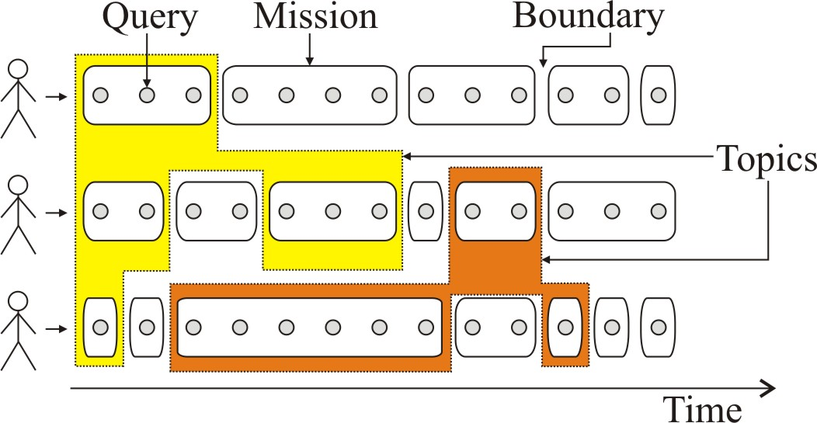
primary objective:
Define a methodology to aggregate different missions within the same cognitive content.

Slide 10
Outline
Introduction
Mission similarity classifier
Greedy agglomerative topic extraction
Experiment
User profiling
Conclusion

Slide 11
Mission similarity classifier
Detection of search missions
Goal: partition the user activity into missions
use the machine learning approach :
is able to detect the boundaries of a mission by analyzing the live stream of actions performed by the user on the search engine.
input
a set of features extracted from a pair of consecutive
query log tuples τ1, τ2 generated by the same user
output
whether τ2 is coherent with τ1, from a topical perspective
Mission detector
Notes:
The features used for the classifications come from three different domains:
1.textual features: include different flavors of lexical similarity between the two queries
2. session features : that measure several aspects of the click activity of the user in the time between the two queries and in the overall session
3. time-related features : take into account the inter-event time distance for some representative user actions.

Slide 12
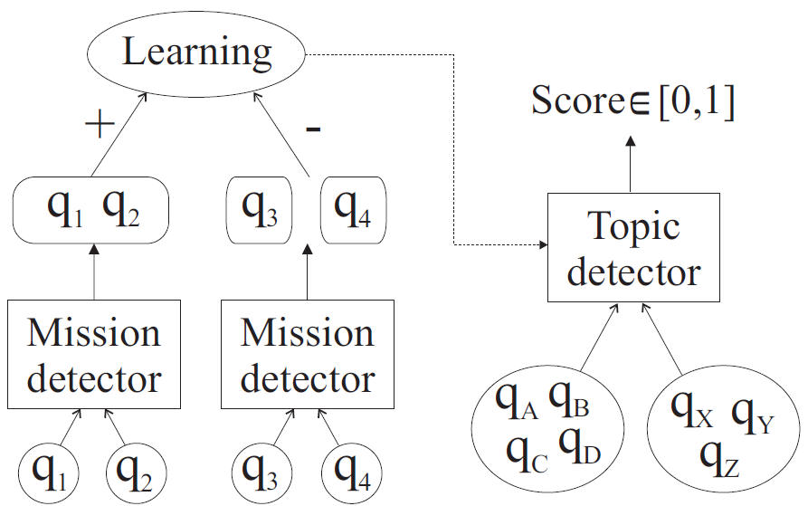
Mission similarity classifier
Merging missions
the strong topical coherence of queries inside the same mission can be exploited to generalize the approach used for mission boundary to a
topic boundary detection.
Goal:
decide whether two query sets belong to the same topic.
Topic detector
Stochastic Gradient Boosted Decision Tree (GBDT)

Slide 13
The features given in input to the classifier are aggregated values over features computed from all the query pairs across two missions.
(given a pair of missions m1,m2, all query pairs q1, q2|q1 ∈ m1∧q2 ∈ m2 are
taken into account.)
Aggregation (min, max, avg, std) of 62 query pair features
Lexical Features | Behavioral features
Length of Common prefix/suffix | Average of session total click
Edit distance | Average of session total time
… | …
The behavior of users during the search activity gives much implicit information on the semantic relatedness of queries.
similarity between the
text of different queries
trained topic detector using a balanced sample of 500K mission pairs extracted from random user sessions over the 2010 query log of the Yahoo! search engine.

Slide 14
Length of Common prefix
Length of Common suffix
String 1: "a b c“
String 2: "a b d"
String 1: "a b a a b a"
String 2: " b b a b a "
Similarity: 2
Similarity: 3
Edit distance
String 1: "kitten“ String 2: "sitting"
Step 1 | kitten → sitten (substitution of 's' for 'k')
Step 2 | sitten → sittin (substitution of 'i' for 'e')
Step 3 | sittin → sitting (insertion of 'g' at the end)
Edit distance between “kitten“ and ”sitting” : 3
Similarity: 1/distance =0.33

Slide 15
Outline
Introduction
Mission similarity classifier
Greedy agglomerative topic extraction
Experiment
User profiling
Conclusion

Slide 16
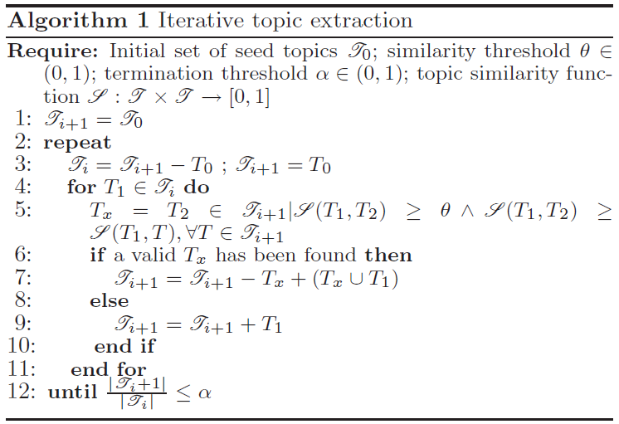
Greedy agglomerative topic extraction

Slide 17
M1
M2
M3
M4
T5
User :
Θ=0.5
α=2.5
Topic 1
Topic 2
Topic 3
User missions of same user
(M2,M1)=0.4
(M3,M1)=0.3
(M3,M2)=0.35
(M4,M1)=0.3
(M4,M2)=0.45
(M4,M3)=0.65
T
Tx
M1
M2
M3
M4
M5
M2
M3
M4
M5
M1
M2
M3
M2
M3
M4
M1
M2
M3
M4

Slide 18
Topic 1
Topic 4
User 1:
User missions of different user
User 2:
Topic 3
Topic 2
1. Missions of the same user →
supermissions
2. Query sets of different users →
higher-level topics

Slide 19
Outline
Introduction
Mission similarity classifier
Greedy agglomerative topic extraction
Experiment
User profiling
Conclusion

Slide 20
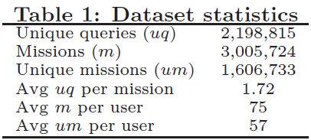
Experiment
Extracted the total activity of 40K users from 3 months of the anonymized Yahoo! query log.

Slide 21
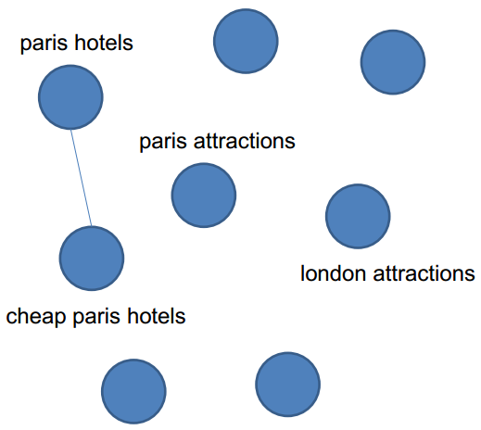
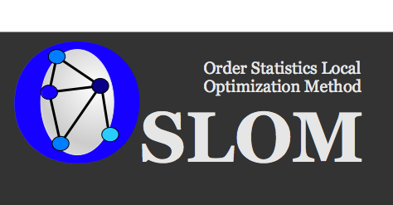
URL cover graph
An edge exists between q1 and q2, if they share clicked URLs
Node weight = #occurrences
Edge’s weight is the number of common clicks
OSLOM community detection algorithm
Weighted undirected graph
Maximizing local fitness function of clusters
Automatic hierarchy detection
graph-based clustering

Slide 22
Experiment
Quantitative comparison
Cluster measure:
1.Query set coverage | fraction of queries that the methodology is considering in the clustering phase
2.Singleton ratio | fraction of queries that remains isolated in singleton at the end of the iterative procedures
3.Aggregation ability | percent of topics that are aggregated in two consecutive iterations or in two consecutive hierarchical Levels
QUERY SET COVERAGE
Greedy Agglomerative Topic Extraction algorithm
GATE: 1
OSLOM 0.2
§1: The GATE algorithm has a full query coverage on the dataset, because, by
definition, every query can be found in at least one mission.
§2:Graph-based clustering algorithms, the sparsity of the graph can lead to the
emergence of isolated components that directly affect query coverage.

Slide 23
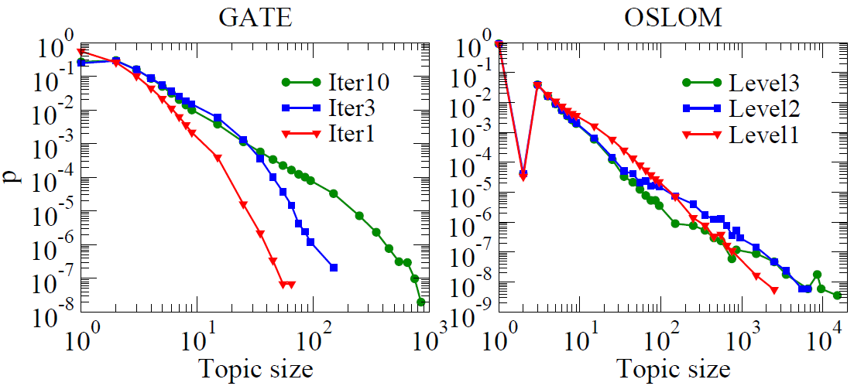
Singleton ratio
GATE: 0.55-0.27
OSLOM 0.88
Notes:
in GATE the number of both medium-size (10-100) and big size (>100) topics grows with the iterations , in OSLOM the medium-size topics that are detected in the first hierarchical level tend to be merged in very large comprehensive and heterogeneous topics, with up to some tens of thousands queries.

Slide 24
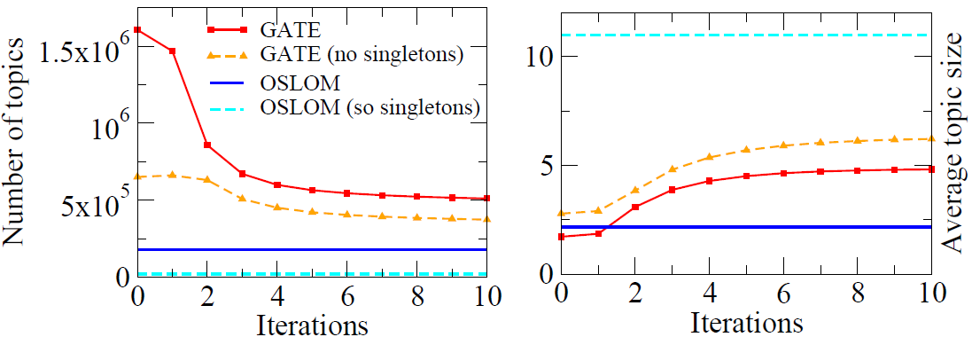
Aggregation ability
GATE: 500k
OSLOM:100K

Slide 25
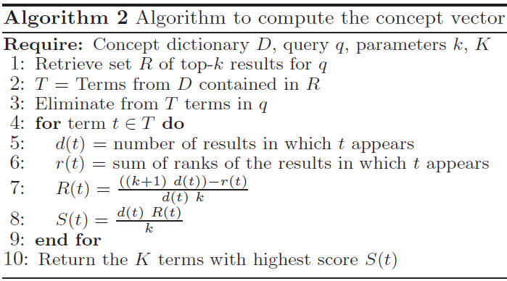
Cluster purity
Qualitative comparison
Construct a bag-of-words vector for each query, consisting of the concepts in the documents returned for this query.
─Average pointwise mutual information
of pairs of query-related relevant terms

Slide 26
Concept Dictionary
T(term set)
Query
Doc 1
Term 1
Doc 2
Term 2
Doc 3
R(set)
Term 3
Term 4
...
...
Doc10
Term n

Slide 27
R
T
Doc 1
Term 1
Doc 2
Term 3
Doc 3
Term 4
...
Doc10
d(t1): 5
r(t1) : 1+2+4+6+7=20
R(t1): $\frac{\text{((10+1)∗5)−20} }{\text{5∗10}}$ = 0.7
S(t1):$\frac{\text{5∗0}\text{.7} }{\text{10} }$ = 0.35
d(t3): 8
r(t3) : 1+2+3+4+5+6+7+8+9=45
R(t3): $\frac{\text{((10+1)∗}\text{8}\text{)−}\text{45} }{\text{8}\text{∗10}}$ = 0.5375
S(t3):$\frac{\text{8}\text{∗0}\text{.5375} }{\text{10} }$ = 0.43
S(t4)
…..
…..
S(tn)
Top 20

Slide 28
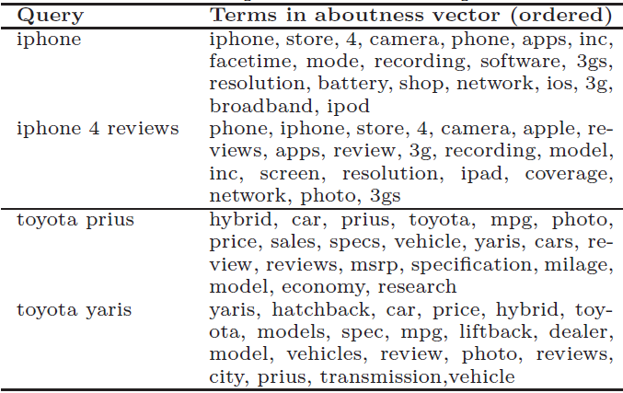

Slide 29
Query 1
Query 2
Query 3
a1 , a2 , t1, a4 ,a5 ,…,t2,…….
b1 , b2 , b3, t2 ,b4 ,……….
c1 , c2 , c3, c4 ,t1 ,……….
Query 4
Query 5
d1 , d2 , d3, d4 ,a5 ,…,t2,…….
t1 , e1 , e2, e3 ,e4 ,…,t2,…….
Log Likelihood Ratio
PMI(t1,t2) = $\frac{2}{3∗4}$ =0.16
PMI(~t1,t2) = $\frac{2}{2∗4}$ =0.25
PMI(t1,~t2) = $\frac{1}{3∗1}$ =0.33
PMI(~t1,~t2) = $\frac{0}{2∗2}$ =0
LLR(t1,t2) =$\frac{2}{5}∗0.16+\frac{1}{5}∗0.33+\frac{2}{5}∗0.25+0=0.23$
Notes:
LLR

Slide 30
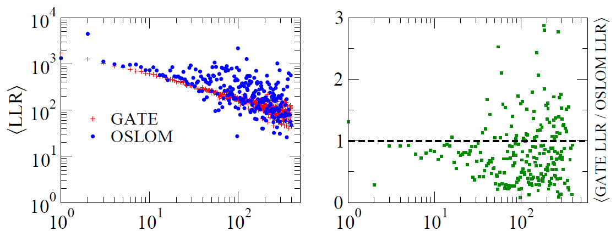
To check how the purity of the topic decreases with its size we computed the correlation between the topic size and LLR by averaging the LLR values of the topics with the same size:
Topic size
Topic size
Notes:
限定topic size(含有的query個數)來進行觀察LLR之變化

Slide 31
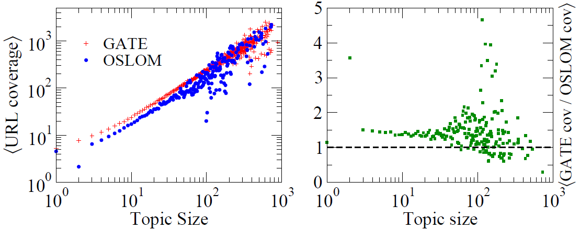
URL coverage
─Number of unique clicked URLs for the query
Given the2010 query logs of the Yahoo! search engine, we extract all distinct URLs clicked by users for each query.

Slide 32
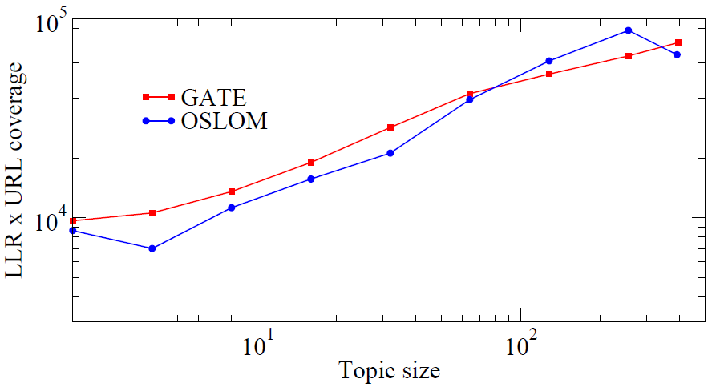
Notes:
1.GATE outperforms OSLOM for all the medium-small topic sizes, that represent the great majority of topics.
2.For clusters containing about 100 queries the two approaches are comparable, and only for some bigger, more rare topics OSLOM achieves the best performance.

Slide 33
Outline
Introduction
Mission similarity classifier
Greedy agglomerative topic extraction
Experiment
User profiling
Conclusion

Slide 34
User profiling
Missions
Topic
Detector
Topics
0.0
1.9
User topical
profile
0.7
3.2
0.0
2.9
0.4
0.0
0.36
0.24

Slide 35
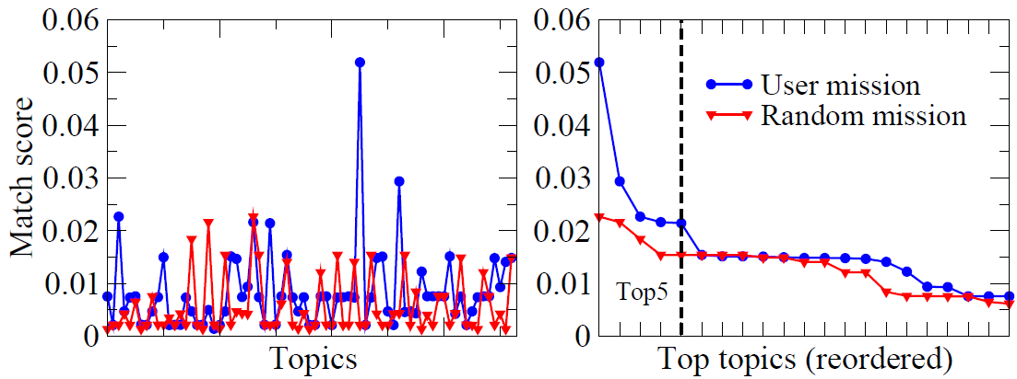
Sequence of missions of the profiled user
vs.
Sequence of missions of the random user
Sequence-profile match using topic detector
Accuracy: 0.65 ( less frequent: 0.72, most frequent: 0.55 )
Notes:
We stress that the mission sequences of randomly selected users are strongly biased toward high-frequency queries such as “facebook”,“amazon” and so on. Since these are shared by a large number of users, any user profile is likely to match them, leading to a decay in detection performance.

Slide 36
Conclusion
Propose a topic extraction algorithm based on agglomerative clustering of sequences of queries that exhibit a coherent user intent.
Compare our method with a graph-based clustering baseline, showing its advantages on query coverage and on the trade-off between purity and url coverage of the clusters.
Topical profile of a user in terms of a topic vector that best defines the user search history.
Consider more sophisticated baselines and more accurate predictions

Slide 37
Thank you
for your Attention !

